Slide 1




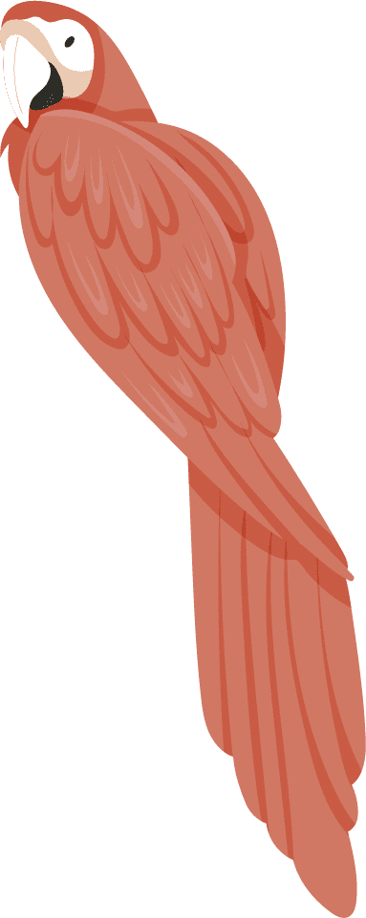





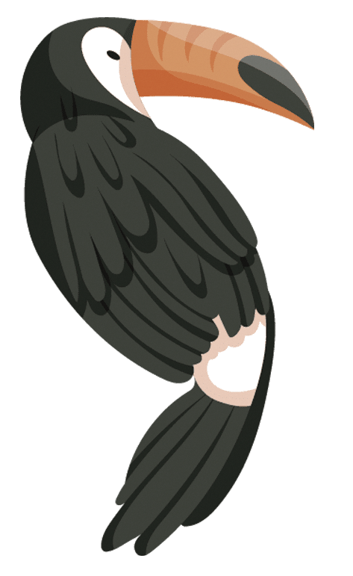

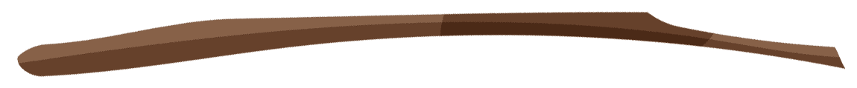

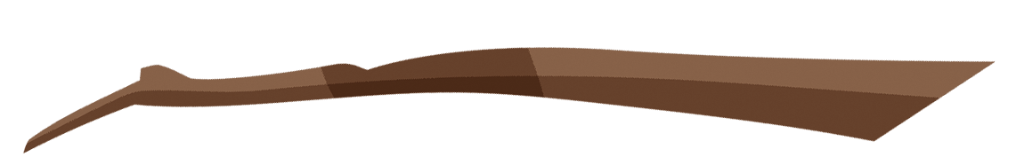





GLOBAL BIODIVERSITY
Annie Vo, Brianna Ta, and Kelly Fan

Slide 2

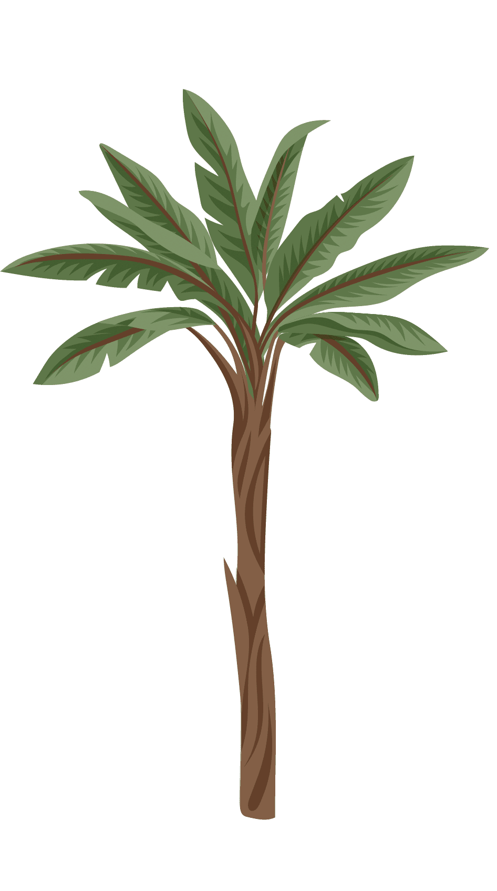


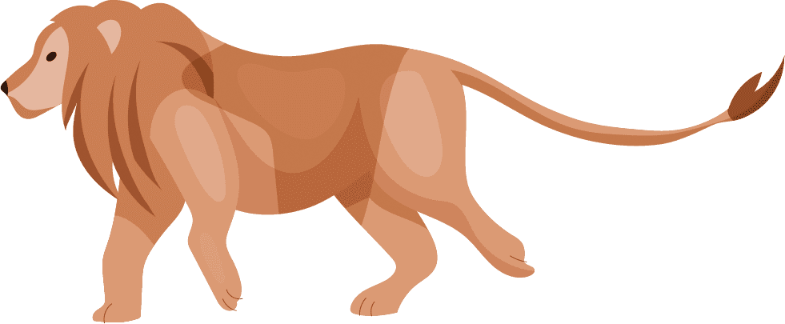
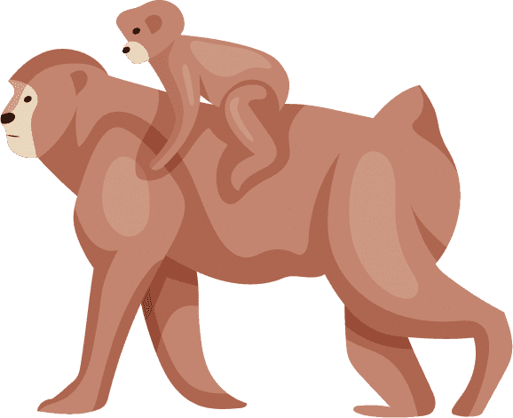

MOTIVATION
Biodiversity is essential for maintaining healthy ecosystems, yet many species face the threat of extinction due to human activities. Our research is motivated by a desire to preserve Earth's biodiversity and understand the impacts of conservation efforts. We focus on tracking animal populations over time, particularly emphasizing endangered species to prevent their extinction.
Notes:
Brianna

Slide 3



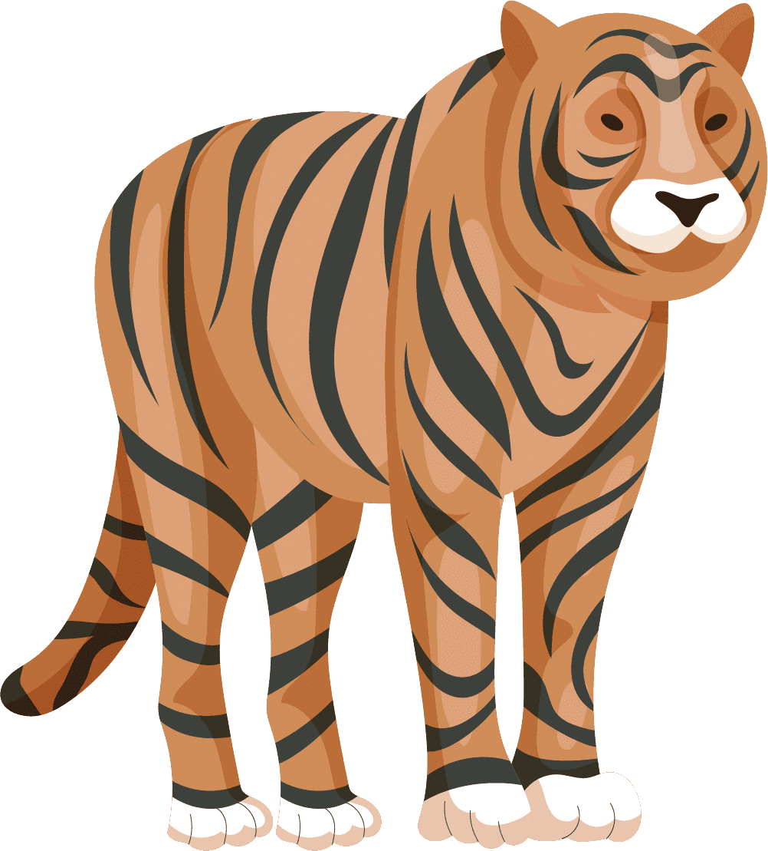

related literary works
taxonomic and geographic bias in lpi
This study aims to mitigate taxonomic and geographic bias in the Living Planet Index by accounting for the estimated number of species and relative diversity.
global vertebrae declines
From the Living Planet Database (LPD), the LPI has measured an average decline of 69% since 1970 of the around 30,000 wildlife populations.
Clustered versus catastrophic global declines
69% decline is due to clustered declines from certain animal populations, rather than catastrophic declines from widespread loss in many animal populations.
Notes:
Annie

Slide 4
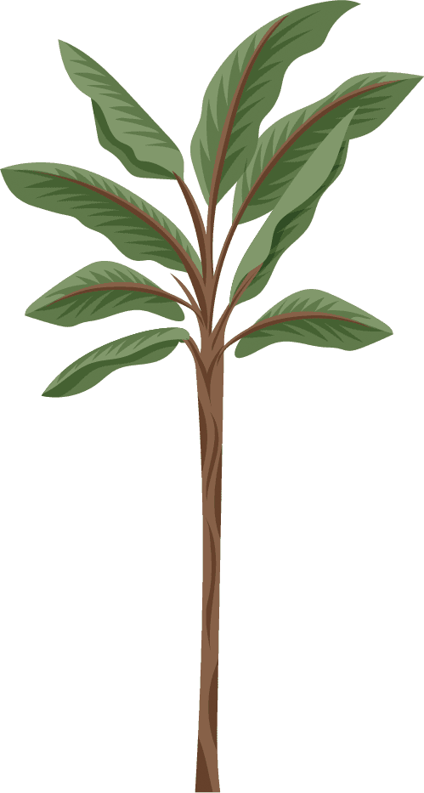
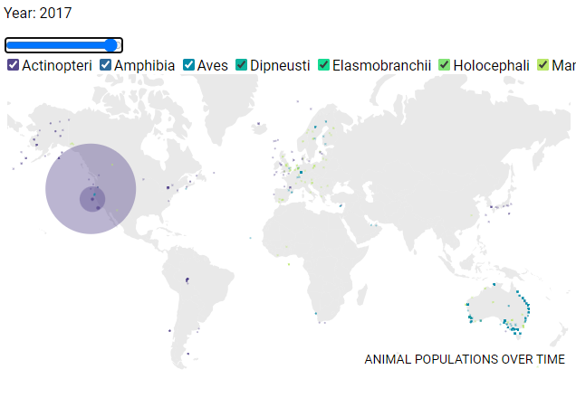

Explore Animal Locations Over Time
Developed in D3
Slider from 1950 to 2020
Filter by animal class
Visualize how populations of animal classes have changed over time
Notes:
Brianna

Slide 5
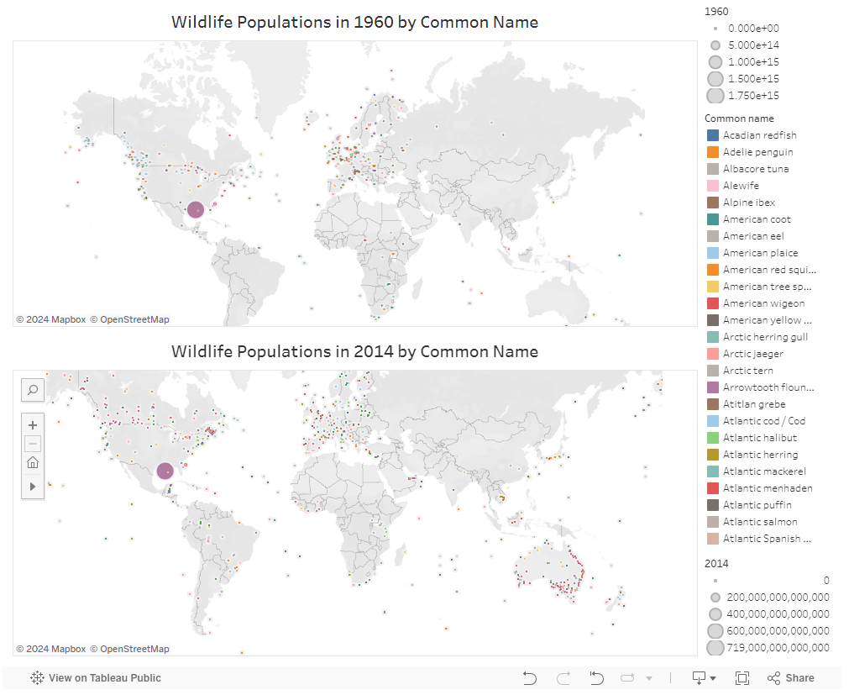
Explore Wildlife Populations by Common Name
Developed in Tableau
Depicts changes in wildlife population between 1960 and 2014

Slide 6



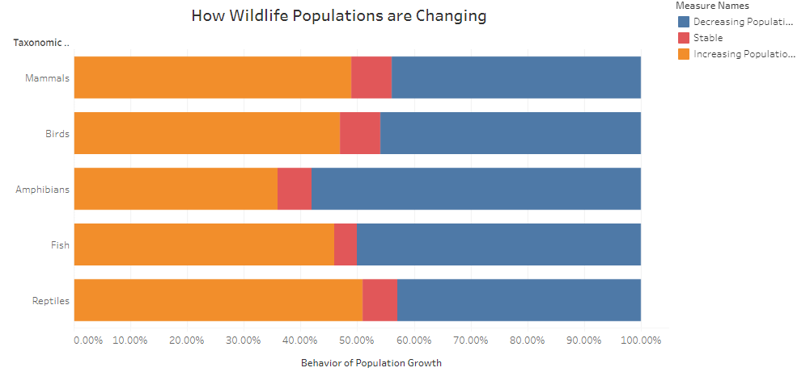


animal populations over time
Developed in Tableau
Shows percentages of decreasing, stable, and increasing populations by animal class

Slide 7
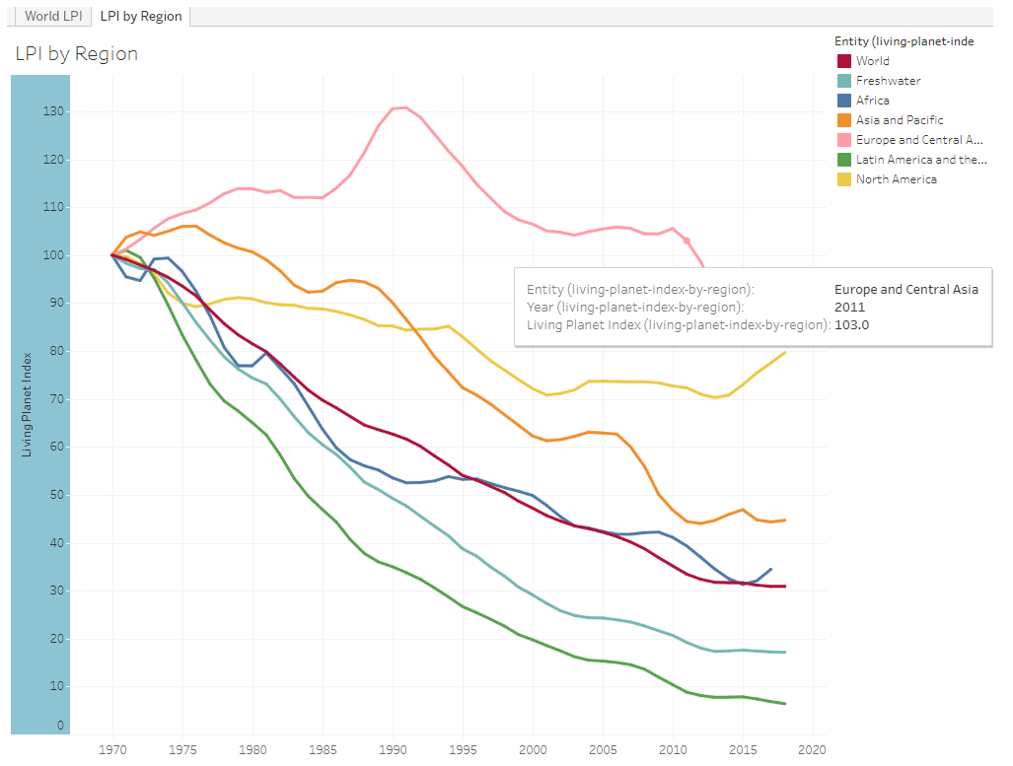



LPI OVer time
Displays the Living Planet Index (overall and by region) over time
Developed in Tableau

Slide 8
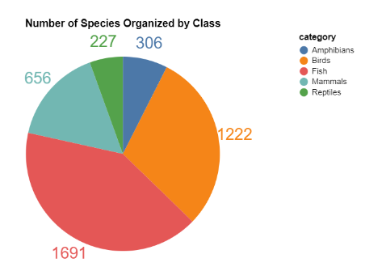
Number of Species by Animal Class
Developed in Altair
Pie chart that displays the number of species by animal class
Notes:
only some thousands of the millions of species in the world

Slide 9
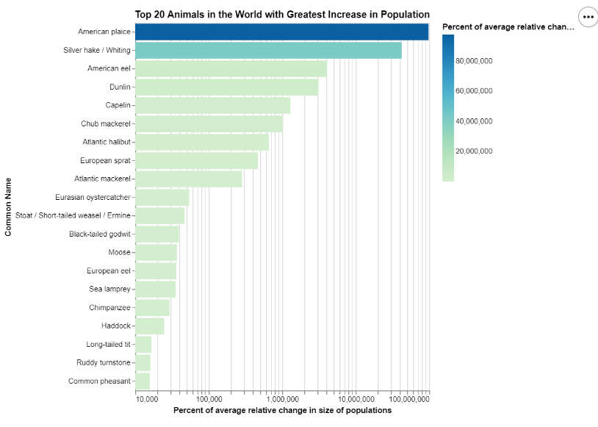
Increase in Animal Populations Over Time
Developed in Altair
Depicts the top 20 animals with the greatest increase in population

Slide 10
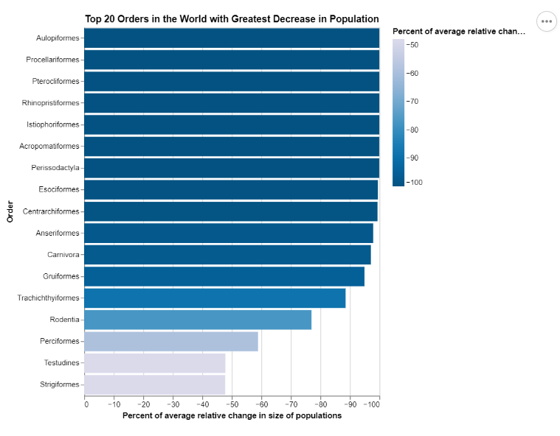
animal orders with greatest decrease
Developed in Altair
Shows the top 20 animal orders that have the greatest decrease in population

Slide 11
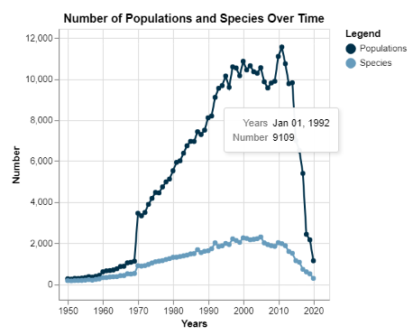
number of species and populations over time
Developed in Altair
Line graph of number of species and populations over time
Notes:
Brianna

Slide 12





discussion
CONSERVATION
TRENDS
Amphibians are at risk, Latin America and Caribbean have low biodiversity
69% average biodiversity decline in vertebrate species
VISUALIZATION
limitations
Dashboard can help inform policymakers and researchers about biodiversity trends
Not enough data from some regions or on invertebrates
Notes:
kelly

Slide 13
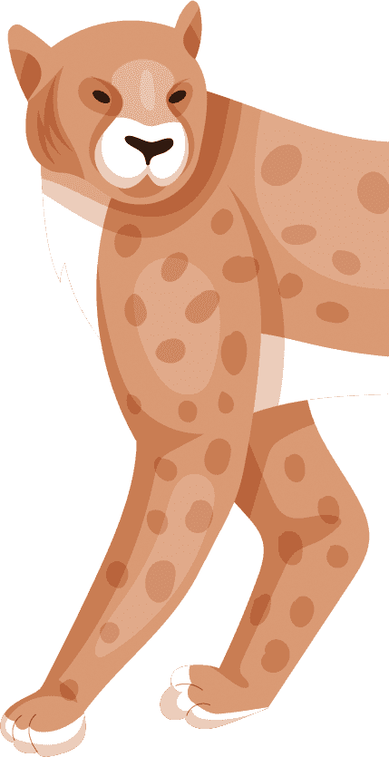
THANKS!

